Slide 1


Ice cloud parameterizations for the Global Climate Models (GCMs)
Victoria Lang, Dr. Dorothea Ivanova, Department of Meteorology

Slide 2

Cirrus clouds
Cirrus clouds – the biggest uncertainty in climate and radiative transfer. The Global Climate Models (GCM) require knowledge of: • ice particle diameter or maximum dimension (D); • ice water content (IWC); • size distributions (SDs).
Very first person to work with this data!

Slide 3

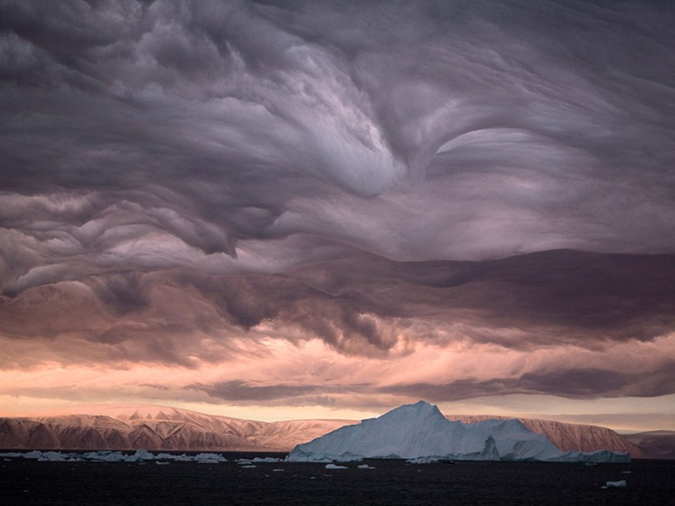

Project Goals
Better understand the role of Ice Clouds in the Earth’s radiative budget
Analyze ice clouds during MARCUS and SOCRATES flights

Slide 4
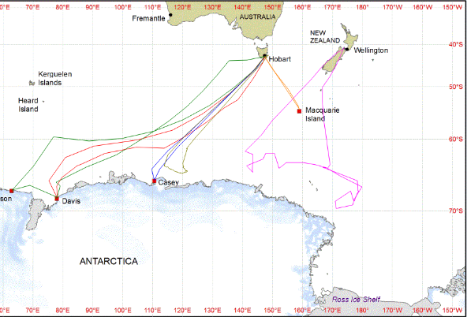
Data
Study based on raw data from ‘Measurements of Aerosols, Radiation and Clouds over the Southern Oceans’ (MARCUS) and ‘Southern Ocean Clouds Radiation Aerosol Transport Experimental Study’ (SOCRATES) experiments
Flight map for data taken during MARCUS and SOCRATES

Slide 5
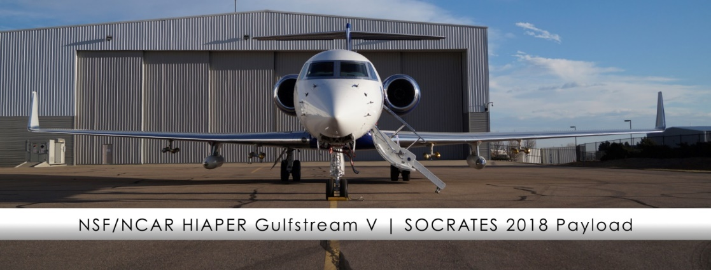
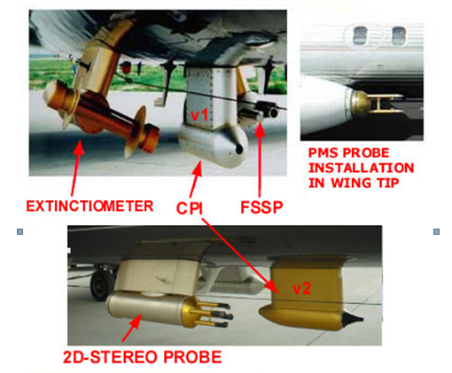
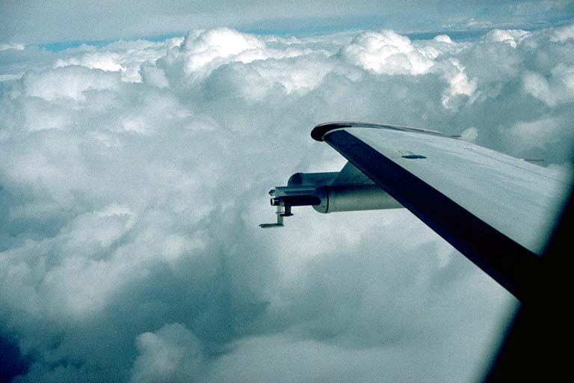
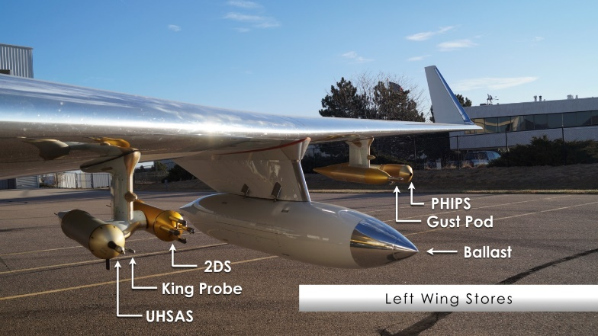
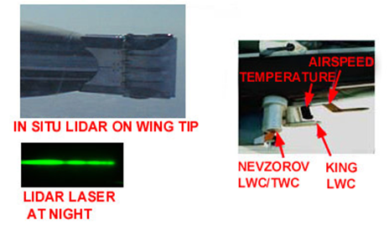
Instruments

Slide 6
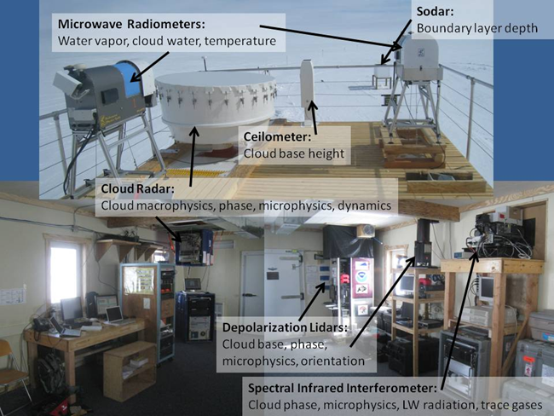
Instruments

Slide 7
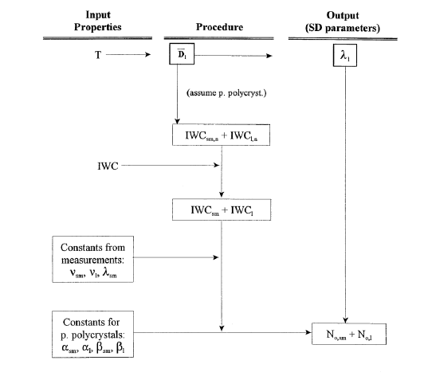
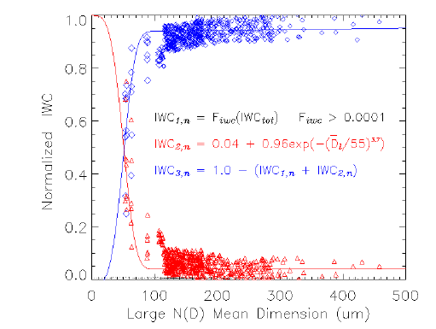

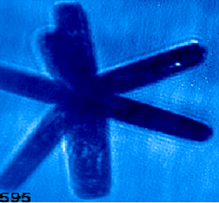
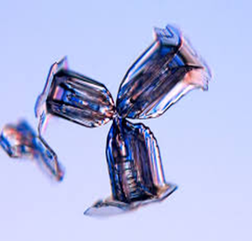
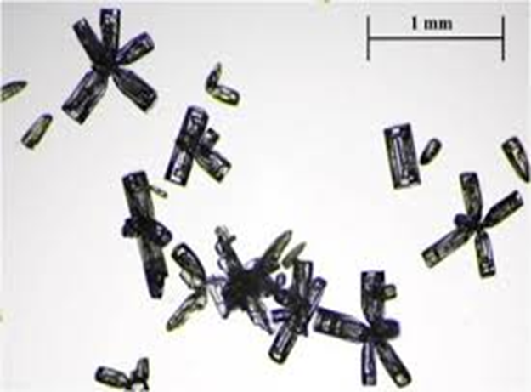
Methodology, Crystal habits and Parameterizations
The Gamma Function:
Observed ice crystal shapes (crystal habits):
Dm: 23.7% columns and irregular,
64.7% bullet rosettes, and 41.6% planar polycrystals.

Slide 8

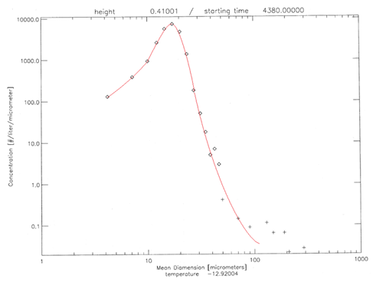
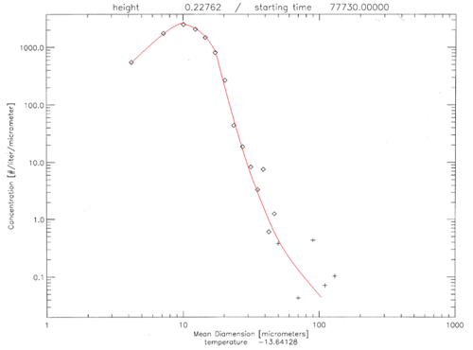
Examples of Size distributions during MARCUS and SOCRATES Concentration vs Mean Dimension
Notes:
The campaighn is under the hat of ARM (Atmospheric Radiation Measurements program), Department of Energy. + modeling. The data is used to create parameterizations for the Global climate model.

Slide 9
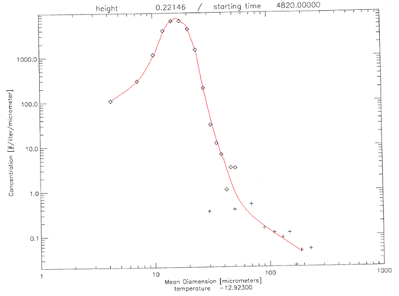
New cirrus parameterizations will be implemented in the GCM
Southern Ocean ice clouds behave differently than mid-latitude and tropical counterparts
More similar to mid-latitude than tropical cirrus, but are more monomodal compared to both tropical and mid-latitude SDs from previous field campaigns
Two modes, small and large, are not clearly distinguished during the Southern Ocean flights; large mode maximum is missing, flattening large mode ice crystal SDs

Slide 10

References
McFarquhar, Greg M. and Andrew J. Heymsfield. “Microphysical Characteristics of Three Anvils Sampled during the Central Equatorial Pacific Experiment.” (Dec. 1995)
Lee, Wei-Liang. “Radiative Transfer in Atmosphere-Ocean and Atmosphere-Mountain systems: Application and Parameterization.” (2008)
Boudala, Faisal S, et al. “The Sensitivity of the Radiation Budget in a Climate Simulation to Neglecting the Effect of Small Ice Particles.” (July 2007)
Ivanova, Dorothea. “Cirrus Cloud Parameterizations for Global Climate Models (GCMs) and North American (Mexican) Monsoon Modeling Study.” (May 2004)
Mitchell, D.L., D. Ivanova, G.M. McFarquhar and T. Nousianen, 2008: The impact of controversial small ice crystals on GCM simulations. Geophys. Res. Lett., 35, L09806, doi:10.1029/2008GL033552.
www.arm.gov/instruments/... (for images used in this presentation)
www.arm.gov/about/mission (for Mission Statement and Logo used in this presentation)

